Slide 1
Software Project Management
Lecturer: Ngo Huy Bien
Software Engineering Department
Faculty of Information Technology
VNUHCM - University of Science
Ho Chi Minh City, Vietnam
nhbien@fit.hcmus.edu.vn

Slide 2

Objectives
To present what is software project management.
To present why software project management.
To select PMI tools and techniques for software project management.
To select software project management approach.

Slide 3

Contents
Project management
Project manager
PMI methodology
Project management approaches

Slide 4

References
Project Management Institute (2017). A Guide to the Project Management Body of Knowledge. 6th Edition.
Kim Heldman (2018). PMP Project Management Professional Study Guide. Sybex.
Murali K. Chemuturi and Thomas M. Cagley Jr. (2010). Mastering Software Project Management - Best Practices, Tools and Techniques. J. Ross Publishing.
Kathy Schwalbe (2017). An Introduction to Project Management. 6th Edition.
Scott Berkun (2008). Making Things Happen: Mastering Project Management.
Roger S. Pressman (2010). Software Engineering: A Practitioner's Approach.

Slide 5

Do We Really Need Project Management?

Slide 6


We Have to Ensure That [1]
Projects will be within cost.
Projects will be delivered on time.
Projects will be within scope.
Projects will meet customer quality requirements.

Slide 7
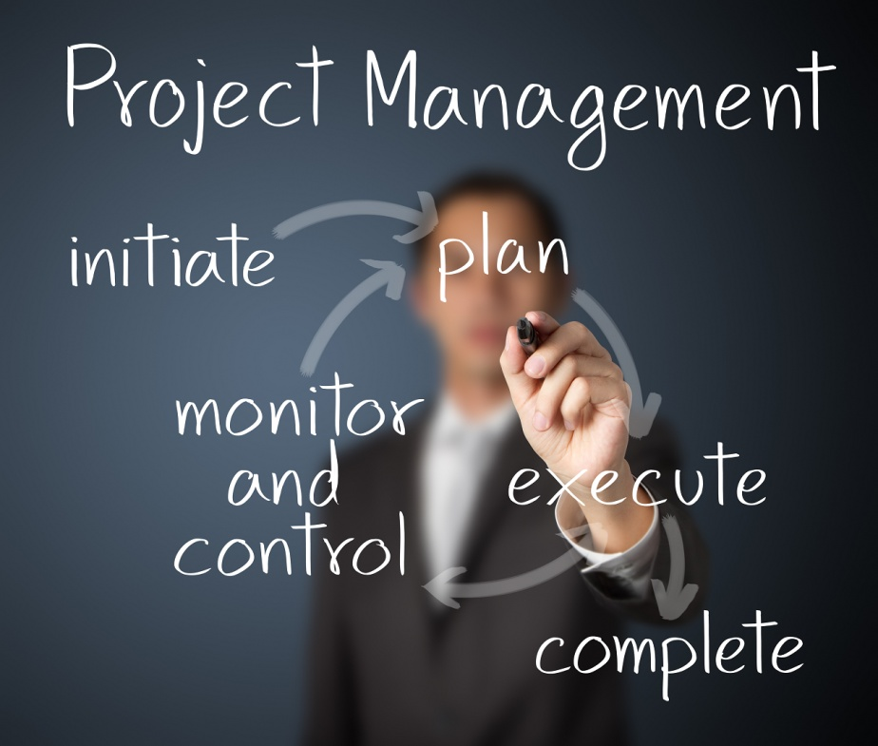
Project Management
Project management is the application of knowledge, skills, tools, and techniques to project activities to meet the project requirements.

Slide 8
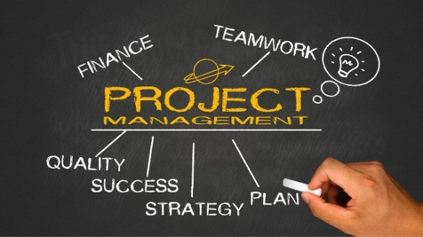
Planning [2]
Project management is a process that includes planning, putting the project plan into action, and measuring progress and performance.
It involves establishing project objectives, identifying the project requirements, balancing constraints, and taking the needs and expectations of the key stakeholders into consideration.
Planning is one of the most important functions you'll perform during the course of a project. It sets the standard for the rest of the project's life and is used to track future project performance.

Slide 9

Why is Software Project Management Hard? [3]
The primary output is not physical. Almost everything is inside a computer.
Despite significant progress in software engineering tools and diagramming techniques, they do not rise to the level of precision of the engineering drawings used in other engineering disciplines.
Professional associations in software development and standards organizations have not defined standards or practices for developing software as has occurred in other engineering practices.
Although significant improvements in software development methodologies have been made, these methodologies are still largely dependent on human beings for productivity and quality.

Slide 10

Art of Project Management
Different situations require different behavior.
This contributes to the idea of project management as an art: it requires intuition, judgment, and experience to use these forces effectively.
Paradoxes
Ego/no-ego
Autocrat/delegator
Tolerate ambiguity/pursue perfection
Oral/written
Acknowledge complexity/champion simplicity
Impatient/patient
Courage/fear
Believer/skeptic

Slide 11



People Involving in Project Management
Project manager
Programmer, designer, business analyst, architect, tester, or other member of a software team
Researcher, consultant or quality assurance manager

Slide 12

Why Project Management? [4]
Project management reduces risks and increases the chance of success.
A good project management discipline will not eliminate all risks, issues and surprises but it will provide standard processes and procedures to deal with them.
How can you avoid the problems that occur when you meet scope, time, and cost goals, but lose sight of customer satisfaction?
The answer is good project management, which includes more than meeting project constraints.

Slide 13


Slide 14

Do We Really Need a Project Manager?

Slide 15

Software Project Manager Hiring
Education: Bachelor of IT/Software Engineering or Information System.
Language: Excellent in English (4 skills).
Have experience in Web development and some technologies (.NET or PHP or JAVA).
Strong knowledge in software engineering process (such as Agile, XP, and/or CMMi) and tools (Jira, MS project).
Strong and confident in problem solving, conflict resolution, negotiation and customer management skills.
Personality: Dedicated, confident, business-minded, pro-active, self-organized, hard-working.

Slide 16
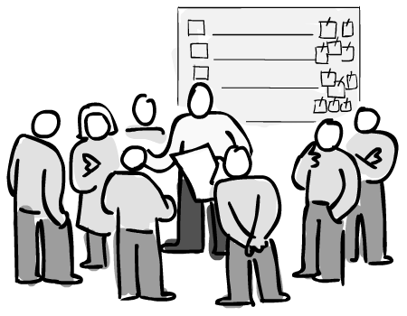
Project Manager's Responsibilities
Define the scope and analyze the feasibility of your project.
Estimate the effort required to do the work and schedule your project.
Manage the requirements, specifications, design, programming, and testing of the software or items purchases.
Manage (coach) the development process of project.
Liaison with customer and management about the project.
Provide guidance if your project runs into quality problems.
Make effective changes to the way projects are run in your organization.

Slide 17

Project Manager's Daily Tasks [5]
Reviewing marketing plans,
Writing visions and statement of work,
Doing strategic planning,
Generating schedules, planning releases,
Leading teams, settling arguments, shielding the team from politics,
Running bug/defect triage,
Doing anything else that needed to be done that no one else was doing (well),
Finding clever workarounds for unexpected situations,
Finding shortcuts and clever optimizations in the daily workflow,
Cultivating team morale, and giving a boost of enthusiasm or encouragement in the right way and at the right time.

Slide 18

Project Manager's Skill Set
Planning, estimating, time management
Contract management
People management (customers, suppliers, functional managers and project team)
Problem solving, negotiation, conflict management
Effective communication (verbal and written)
Influencing
Creative thinking
Leadership

Slide 19

A Way to Guarantee Failure
Use a technical lead that has never built a similar system.
Build the system in Java, even though most of the development team still thinks that Java is coffee.

Slide 20
Project Manager's Contribution
The PM will understand
the business view of the project as well as
the technical view, and
he'll help the team translate between them when necessary.
Good project managers know all kinds of useful things about
the state of the team, and
the state of the world, and then
apply that knowledge to help people get stuff done.
Because these contributions are harder to measure, many PMs struggle with the ambiguity of their role.
It takes a combination of conviction, confidence, and awareness to be effective and happy as a leader of a team.

Slide 21

PM's Contribution Example
Consider that in hospital emergency rooms, one doctor takes the lead in deciding the course of action for a patient.
This expedites many decisions and gives clarity to the roles that everyone on the trauma team is expected to play.

Slide 22

The Absence of a Dedicated PM
As long as everyone is willing to pay the tax of responsibility for keeping things together, and distributing the burden that a dedicated project manager would carry for the team, there's one less employee that the team needs.
Efficiency and simplicity are good things.

Slide 23

Possible Issue
Without a person whose primary job is to shepherd the overall effort, individual biases and interests can derail the directions of the team.
Strong adversarial factions may develop around engineering and business roles, slowing progress and frustrating everyone involved.

Slide 25

How to Manage a Project? [6]
Understand the four P's—product, process, project and people.
Communication with the customer and other stakeholders must occur so that product scope and requirements are understood.
A process that is appropriate for the people and the product should be selected.
The project must be planned by estimating effort and calendar time to accomplish work tasks: defining work products, establishing quality checkpoints, and identifying mechanisms to monitor and control work defined by the plan.
People must be organized to perform software work effectively.

Slide 26
PMI Project Life Cycle [1]
Project management is the application of knowledge, skills, tools, and techniques to project activities to meet project requirements.
How many activities are there?
Understand the project life cycle.
A project life cycle is the series of phases that a project passes through from its initiation to its closure.
Project phases are divisions within a project where extra control is needed to effectively manage the completion of a major deliverable.
Starting the project
Organizing and preparing
Carrying out the work
Closing the project

Slide 27
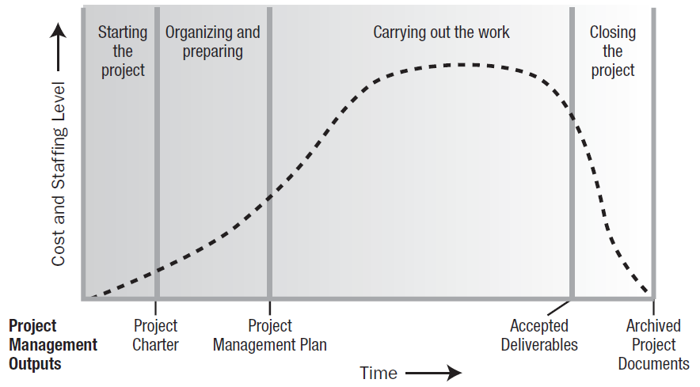
How to Organize Cost, Staffing and Work Products ?
Typical Cost and Staffing Levels Across the Project Life Cycle

Slide 28
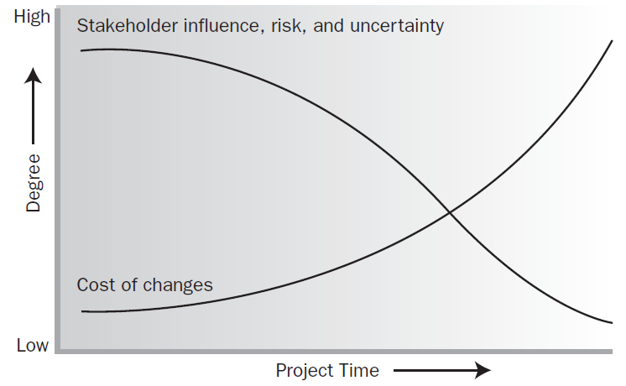
How to Manage Changes and Risks?
Impact of Variables Based On Project Time

Slide 29
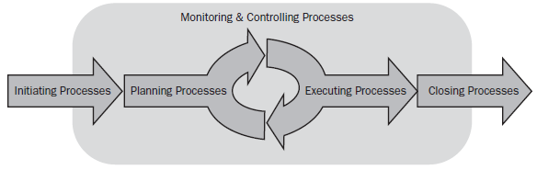
Typical Project
Project phases are typically completed sequentially.
Example of a Single-Phase Project

Slide 30
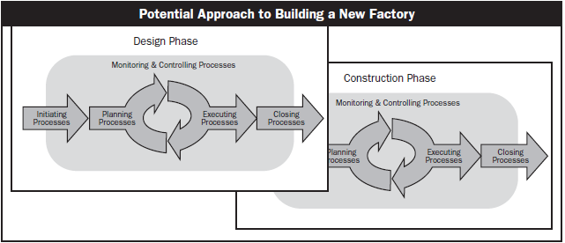
Complex Project
The phase structure allows the project to be segmented into logical subsets for ease of management, planning, and control.
The number of phases, the need for phases, and the degree of control applied depend on the size, complexity, and potential impact of the project.
A Project with Overlapping Phases

Slide 31
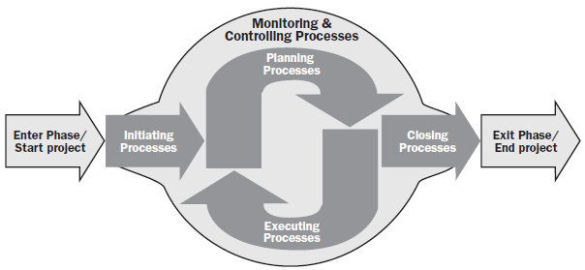
Project Management Processes
How to manage a project easily and effectively? – Use appropriate processes.
Project management processes are grouped into five categories known as Project Management Process Groups (or Process Groups)
4
5
1
2
3

Slide 32
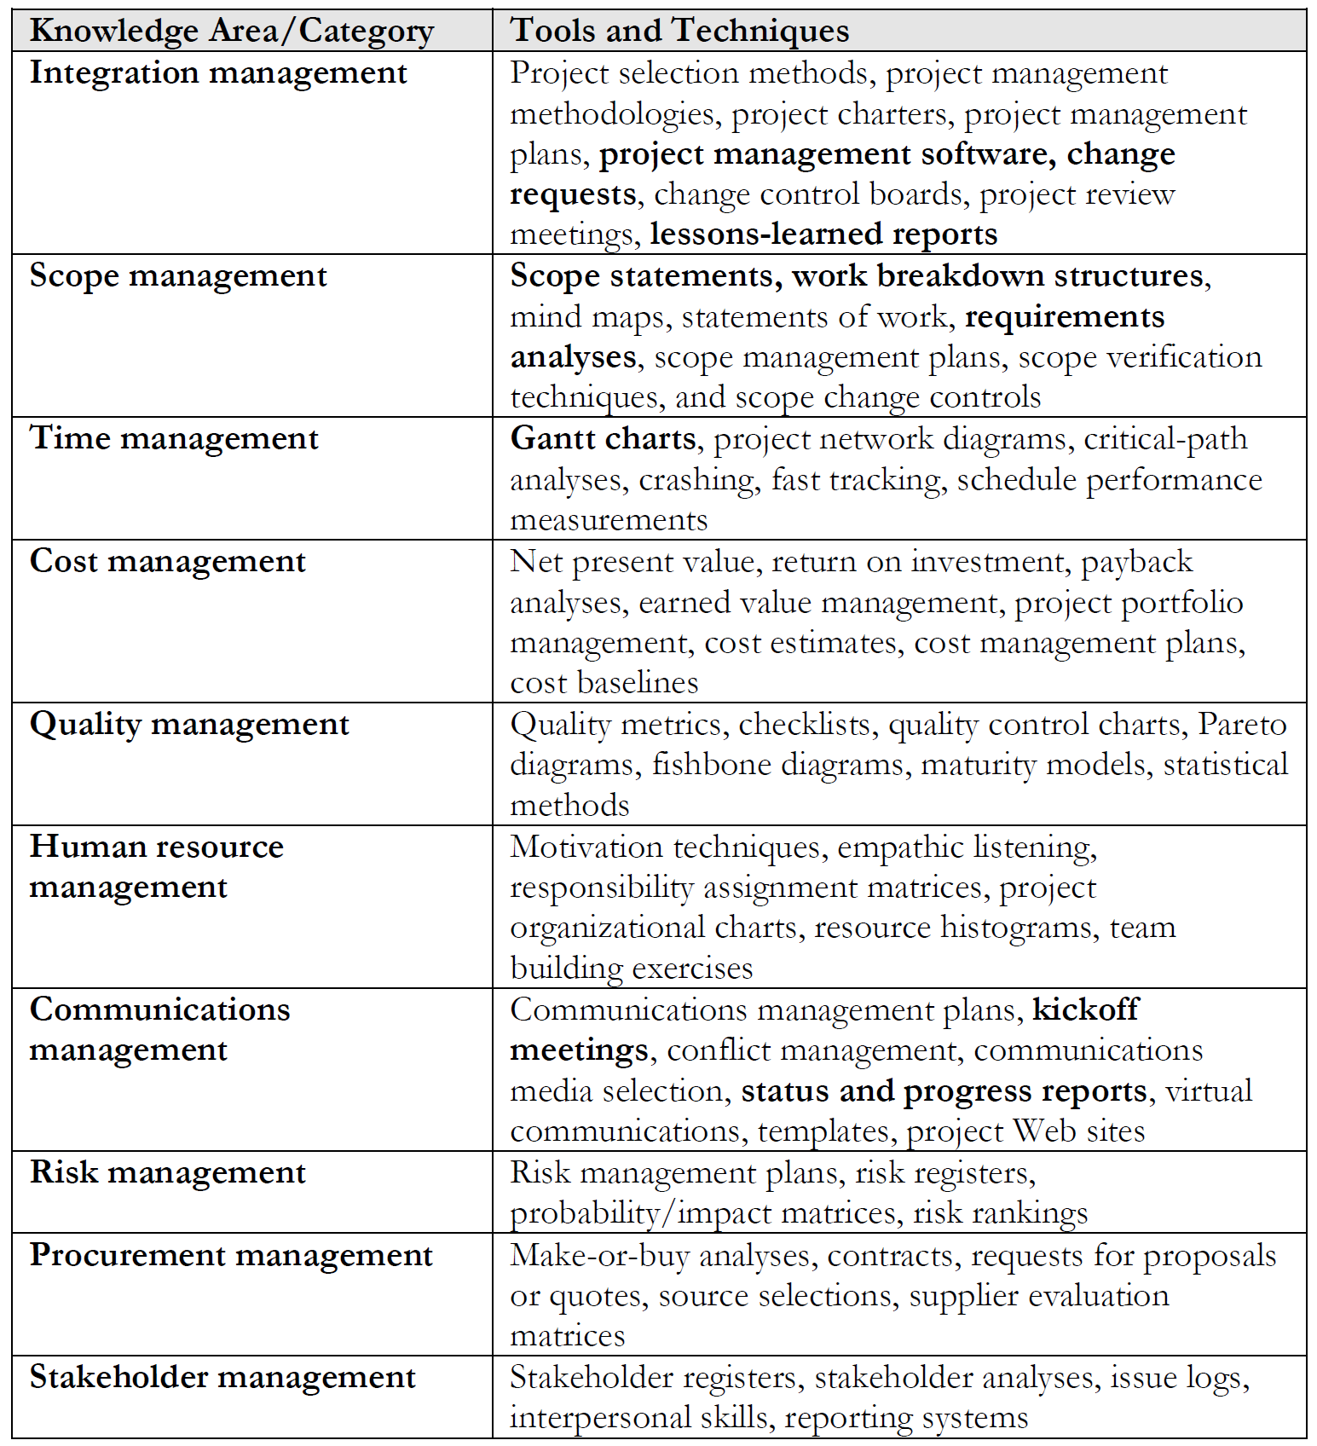
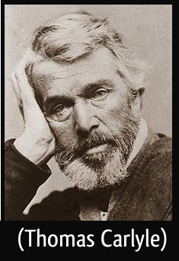
PMI Tools and Techniques [5]
Man is a tool-using animal.
Without tools he is nothing, with tools he is all.

Slide 34

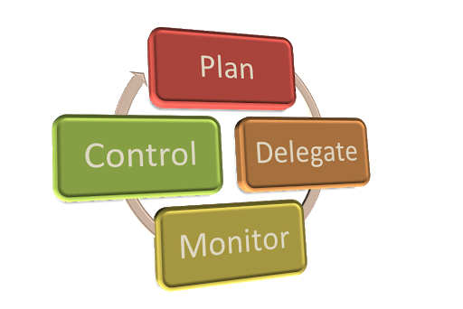
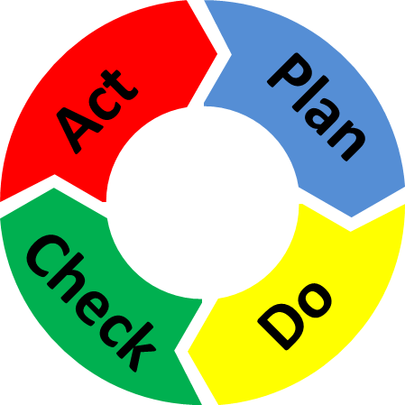
Engineering and Management [3]
Software project execution has two components, namely, software engineering and management.

Slide 35

Software Engineering
Software engineering consists of all of the technical activities that are performed to build the project deliverable (the “just build it” activities).
Software engineering deals with
specifying product requirements,
constructing the components,
integrating them,
verifying them,
validating them, and
finally combining all of the components into a product and
convincing the customer to accept delivery of it.

Slide 36
SE Methodologies: Waterfall vs. Agile
Week 1
Requirements
Week 2
Requirements
Week 3
Solutions
Week 4
Solutions
Week 1
Requirements
Solutions
Week 2
Requirements
Solutions
Week 3
Requirements
Solutions
Week 4
Requirements
Solutions

Slide 37
SE Methodologies: Waterfall vs. RUP
Week 1
Requirements
Week 2
Requirements
Week 3
Solutions
Week 4
Solutions
Week 1
Requirements
Week 2
Requirements
Solutions
Week 3
Requirements
Solutions
Week 4
Solutions

Slide 38

Management
Management facilitates software engineering so that the project deliverable is completed on time, efficiently (low cost) and effectively (right goals), and without defects.
Management deals with
creating visions,
estimating time and cost,
coordinating members and business,
solving conflicts,
handling unexpected situations, and
optimizing the daily workflow.

Slide 39

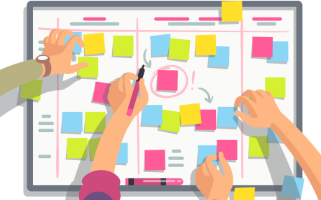

Project Management Methodology (I)
Project management methodology is incorporated into the software engineering methodology adopted for building the project deliverable.
Management
(Waterfall, RUP,
Scrum, Kanban)
Software Engineering
(Waterfall, RUP,
Scrum, Kanban)
Development Team
Business Team

Slide 40


Project Management Methodology (II)
Software engineering and management are loosely coupled, but they do influence each other.
Each aspect needs some amount of tailoring to suit the other.
Software Engineering
(Waterfall, RUP,
Scrum, Kanban)
Management
(PRINCE2, PMI)
Business Team
Development Team
influence

Slide 41
Managing PM Methodology (I)
Ad hoc methods (e.g., process definition, maintenance groups, measurement, and analysis) are NOT documented and are dependent on the involved parties.
In an ad hoc method approach, a software project manager (SPM) is given almost absolute control within a general policy framework that tends to be rather flexible.
In this situation, often the management style also reflects the personality of the leader of the organization.
Advantages: least costly, and the most profitable
Disadvantages: lose the leader, lose the project

Slide 42
Managing PM Methodology (II)
Organizations using a process-driven approach are characterized by having documented processes for all activities.
Individuals must also be knowledgeable in the processes that concern them to be effective and efficient.
The organization facilitates the execution of projects by providing the processes, the tools, a knowledge repository, the training, and expert assistance as needed to help the SPM(s).
Each SPM is responsible for executing projects while diligently conforming to defined processes provided by the organization.
SPMs also are responsible for providing feedback, suggestions, and support for the organizational initiatives in continuous improvement of processes, tools, and the knowledge repository.
Disadvantages: Cost. Advantages: minimizing the person-dependency, predictability in project execution.

Slide 43
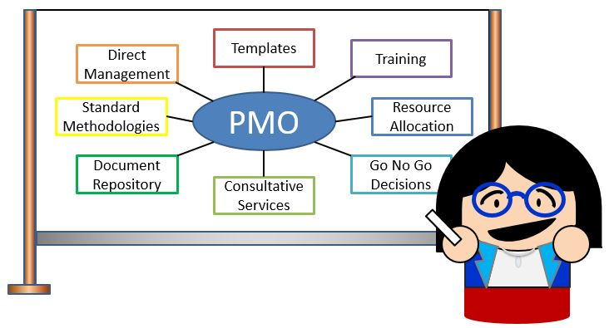
Project Management Office [2]
Notes:
The PMO is usually a centralized organizational unit that oversees the management of projects and programs
throughout the organization.
The most common reason a company starts a project management office is to establish and maintain procedures and standards for project management methodologies.

Slide 44
What is the Right Approach? [3]
Most organizations that evolve in an organic manner start small, typically beginning with an ad hoc approach to software project management.
As the organization grows and takes on more projects, the workload increases, putting pressure on the human resources.
As this pressure on the human resources builds up, two things can happen:
the organization buckles under the pressure and moves toward stagnation, failure, and closure or
the organization moves toward a process-driven approach.

Slide 45

Thank You & See You Again

